Slide 1

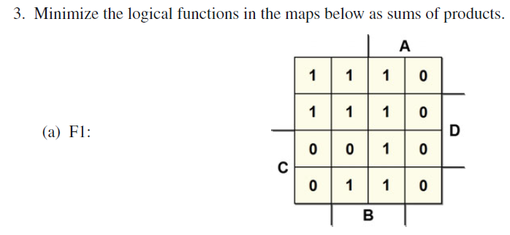

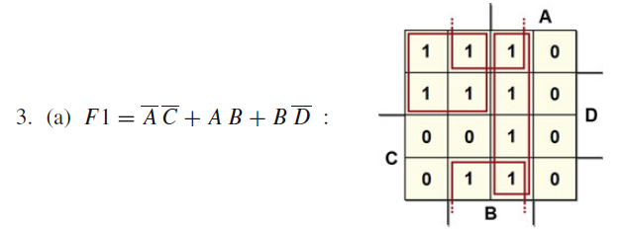
AB
CD
00
01
11
10
00
01
11
10

Slide 2
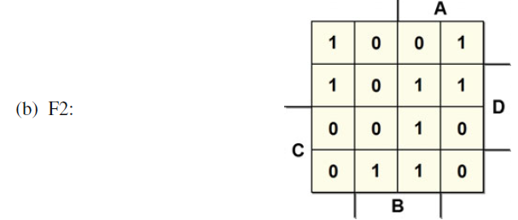
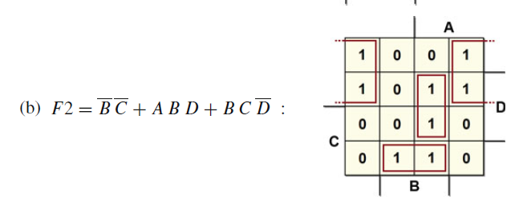
AB
CD
00
01
11
10
00
01
11
10

Slide 3
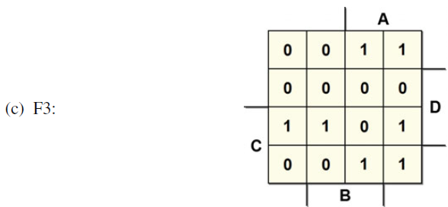
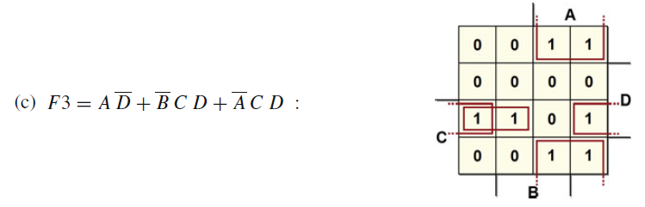
AB
CD
00
01
11
10
00
01
11
10

Slide 4
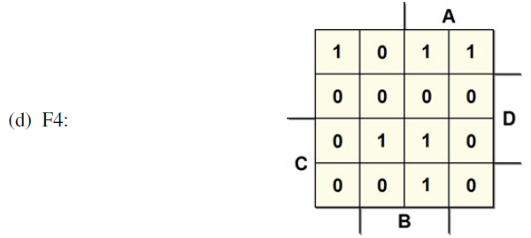
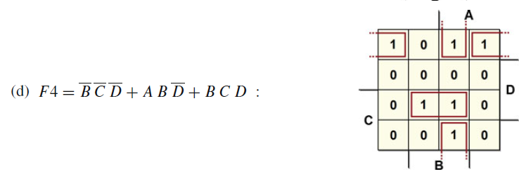
AB
CD
00
01
11
10
00
01
11
10

Slide 5

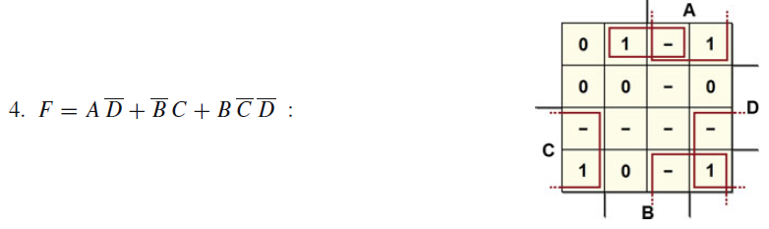
AB
CD
00
01
11
10
00
01
11
10

Slide 6
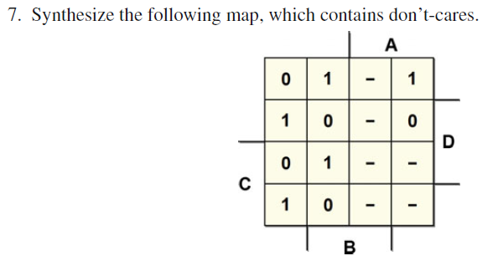
AB
CD
00
01
11
10
00
01
11
10

Slide 7
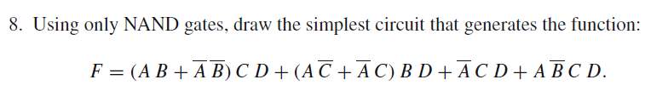
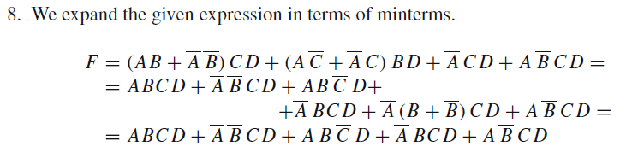
$$=ABCD+\overline{A}\overline{B}CD+AB\overline{C}D+\overline{A}BCD+\overline{A}BCD+\overline{A}\overline{B}CD+A\overline{B}CD$$

Slide 8
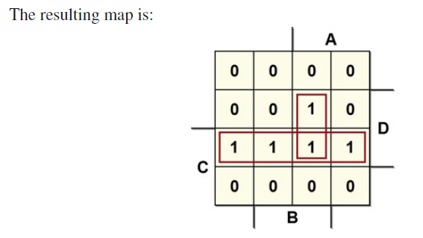
AB
CD
00
01
11
10
00
01
11
10

Slide 9

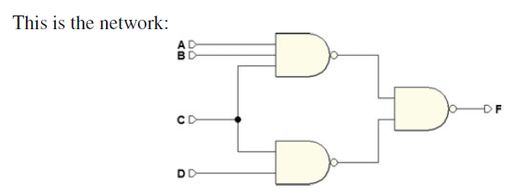

Slide 10
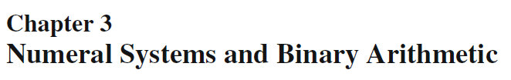
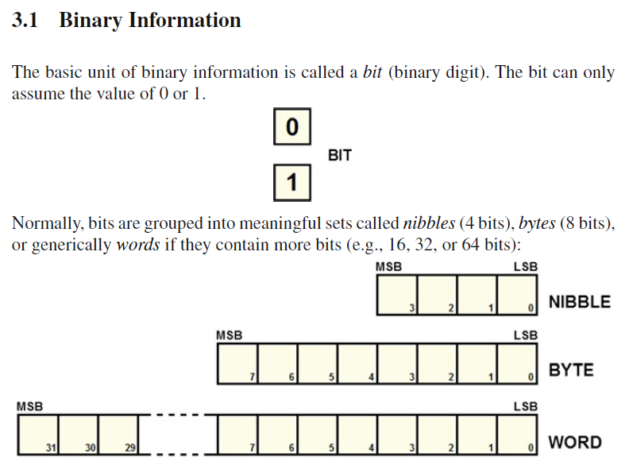
MSB is the Most Significant Bit
LSB is the Least Significant Bit

Slide 11

Like the decimal system, binary numbering is positional. Positional notation makes it possible to express a number N as:
R is the base of the system;
m is the number of digits the representation is composed of;
exponents denote the position k of each digit from 0 to m − 1 starting from the right;
set A = {0, . . . , R − 1} is the alphabet of the numbering system and is made up of symbols we use to represent numbers;
coefficients n are the numbers that correspond to the value of the symbols in set A.

Slide 12
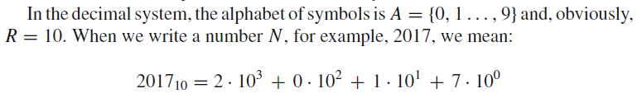
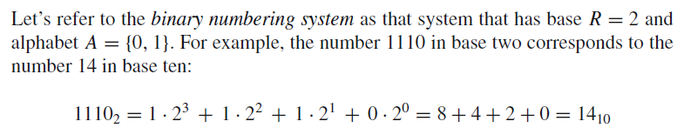
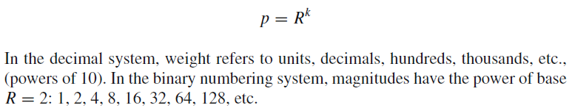

Slide 13
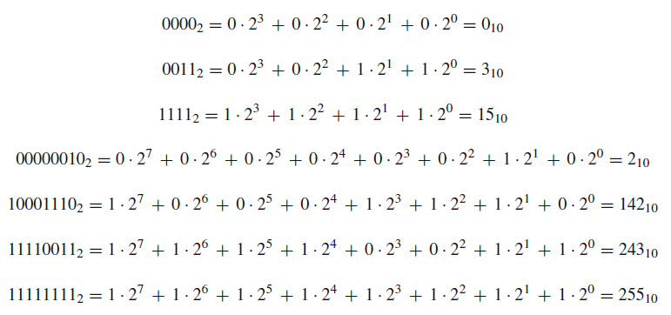
Here are examples for 4 and 8 digits:

Slide 14




A natural number N (with N ≥ 2) can be expressed as:
quotient
remainder of the division of N by 2
We can repeat this process
By substituting :

Slide 15

A natural number N (with N ≥ 2) can be expressed as:
quotient
remainder of the division of N by 2

Slide 16
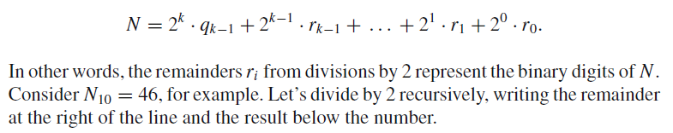
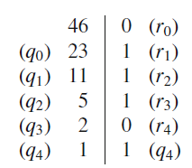
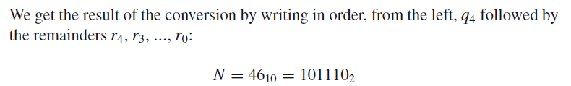
Let’s divide by 2 recursively, writing the remainder at the right of the line and the result below the number:

Slide 17
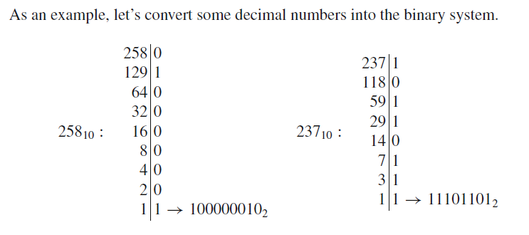
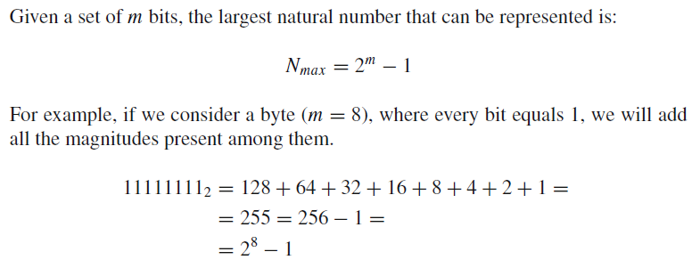

Slide 18
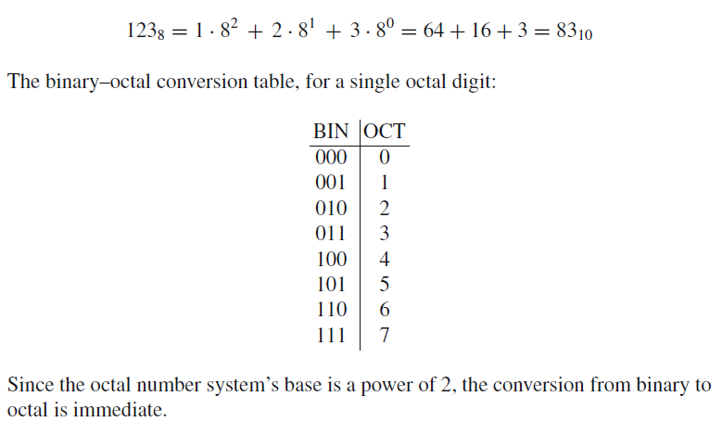
This is a base R = 8 positional numbering system with alphabet:
A = {0, 1, 2, 3, 4, 5, 6, 7}
It is used to represent binary numbers but it is rarely used today, being replaced by the hexadecimal system.
Below is an example:
Since the octal number system’s base is a power of 2, the conversion from binary to octal is immediate.

Slide 19
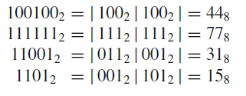
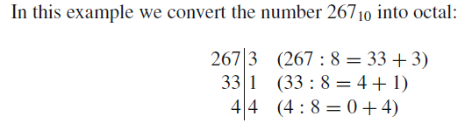

Converting any binary number into octal requires just dividing it into groups of three digits (starting from the right) and replacing each with the corresponding octal digit.
See the examples below:
An integer decimal number can be converted into octal by using the method of repeated division learned for decimal to binary conversion, in this case dividing by 8.

Slide 20
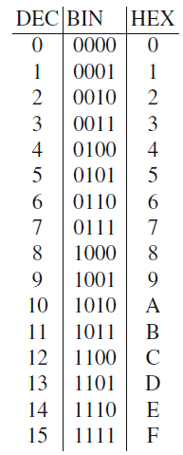
This is a positional number system with base R = 16. Its alphabet is:
To represent digits higher than 9 we use the first six letters of the Latin alphabet since they are available on a typical keyboard.
DEC − BIN − HEX conversion table is as follows:

Slide 21
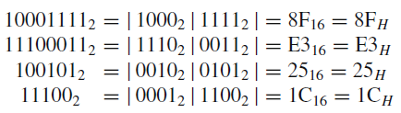
Since the hexadecimal number system is also based on the power of 2, the BIN–HEX conversion is immediate.
We replace every group of four binary digits with the corresponding HEX digits. Here are some examples:

Slide 22
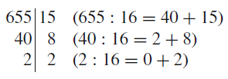

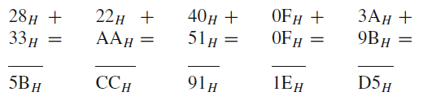
DEC–HEX conversion can also be done with repeated division, by dividing by 16.
Let’s look at some examples of column addition with two numbers.
When a digit is over 15, we carry it over one column.:
15
10
15
12
30
Divide by 16

Slide 23


decimal-to-binary and binary-to-decimal conversion becomes more complex as the numbers get bigger.
To make the conversion easier, we can represent the digits of a decimal number one by one, using the Binary Coded Decimal (BCD)
They code the decimal numbers’ digits one by one using groups of four bits.
Let’s look at some of the most commonly used BCD codes:

Slide 24
Binary codes are said to be weighted if every digit has its own weight according to its position.
Those in which every combination of digits is randomly associated to a certain number are called non-weighted.

Slide 25
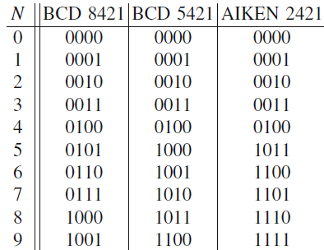
Self-complementing codes are those where two numbers that add up to 9 are complements to one of each other (i.e., the 1s and 0s are interchanged).

Slide 26

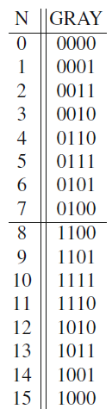
The GRAY codes are non-weighted.
Each number differs by one single digit from the one that precedes it and the one that follows it.
GRAY codes can be made with any number of bits. There are many types of GRAY codes. The one shown here is the “reflected” type:

Slide 27
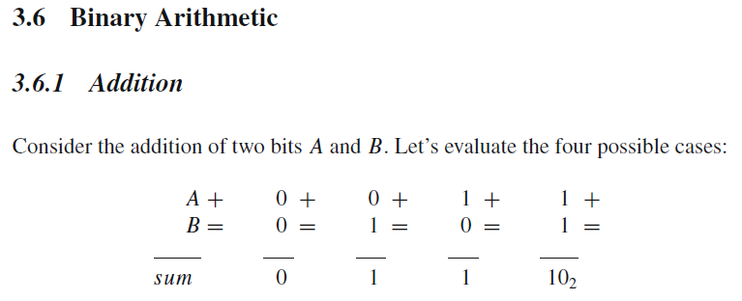
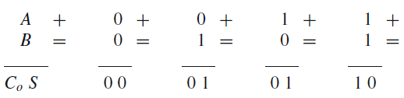
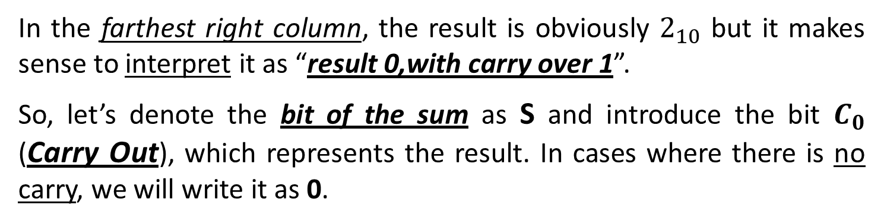
In the farthest right column, the result is obviously $2_{10}$ but it makes sense to interpret it as “result 0,with carry over 1”.
So, let’s denote the bit of the sum as S and introduce the bit $C_{0}$ (Carry Out), which represents the result. In cases where there is no carry, we will write it as 0.

Slide 28
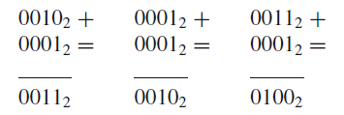
When we add binary numbers coded on more than one bit, the carry generated from one column must be added to the result from the column to its immediate left, as in the following examples:
two right-hand columns have carries
no carries
there is one carry in the farthest right column

Slide 29
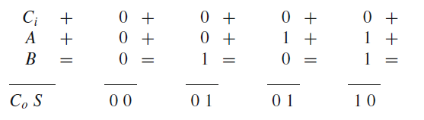
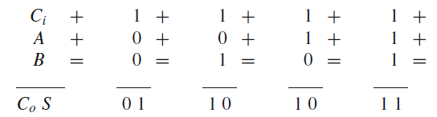
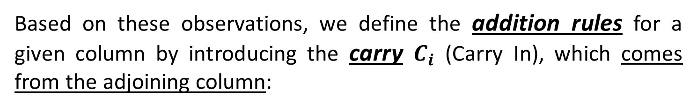
Based on these observations, we define the addition rules for a given column by introducing the carry $C_{i}$ (Carry In), which comes from the adjoining column:

Slide 30
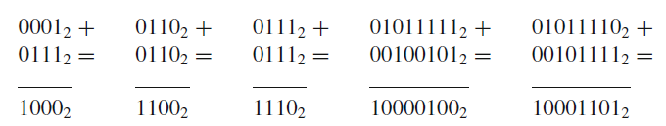
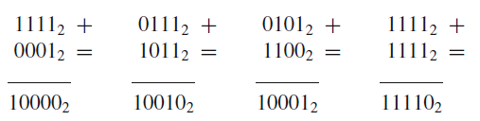
Some examples of binary number addition:
When calculating the sum of two numbers, the result could exceed the maximum representable number.
If, for example, in our logical network we have only 4 bits available to code a number, the following sums generate a result that is too large:

Slide 31
If, for example, in our logical network we have only 4 bits available to code a number, the following sums generate a result that is too large:
To contain the result, we need 5 bits. An overflow error has occurred.
After calculating a sum, we must always check for an overflow error, that is if anything has carried over from the column of the MSB (most significant bit).
This rule holds for numbers without signs. Next, we will see how to check for overflow with numbers that can be positive or negative.

